Slide 1

Smart Traffic Violation Detection
Autonomous AI Framework for Urban Road Safety
Proposed Conceptual Idea & Technical Requirements

Slide 2




The Problem: Manual Enforcement Gap
Human Limitations
Deterrence Failure
Standard traffic monitoring depends almost entirely on physical presence of officers. This model fails to scale across vast city networks, especially during late hours or extreme weather.
Because the risk of being caught is low, dangerous habits—like signal jumping and riding without helmets—become normalized, leading to preventable accidents.
We propose a shift from reactive human monitoring to proactive AI-driven automation.

Slide 3

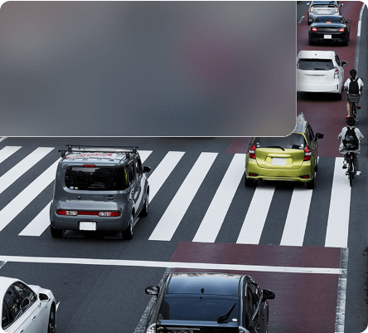
The Solution: Active Surveillance
Proposed Idea Overview
Our concept transforms existing CCTV infrastructure into an intelligent, autonomous enforcement network. The system is designed to watch live feeds and flag violations automatically.
•
Modular Pipeline: Splitting the workload into specialized models for higher reliability.
•
Continuous Operation: Round-the-clock monitoring without fatigue or bias.
•
Integrated Evidence: Automatic logging of plate numbers, violation types, and timestamps.

Slide 4






Proposed Modular Architecture
Isolated Inference
Optimized Execution
Logic Reliability
By using separate models for helmets, signals, and occupancy, we can refine individual components without rebuilding the entire system core.
The proposed framework utilizes ONNX for CPU-optimized inference, ensuring it can run on existing smart-city hardware infrastructure.
Rule-based cross-validation (e.g., checking light color against vehicle movement) ensures detections are logically sound before logging.

Slide 5




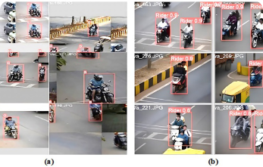

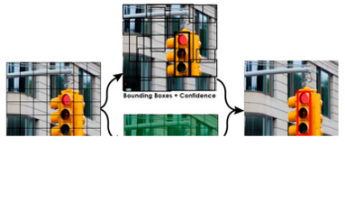

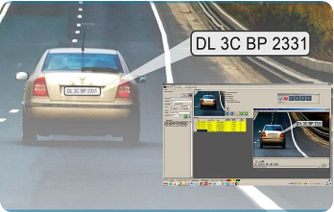
Core Detection Components
Rider Compliance
Signal & Scene
Identification
Detecting helmet usage and passenger count on motorcycles.
Classifying traffic light states and identifying lane regions.
Localizing license plates and extracting alphanumeric text via OCR.

Slide 6
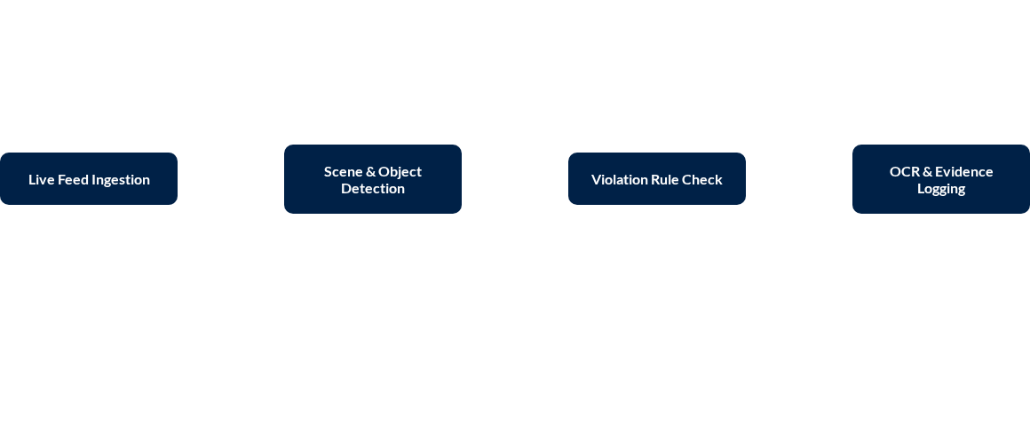
The Envisioned Processing Flow
The system continuously processes incoming frames, maintaining vehicle IDs via ByteTrack to ensure violations are linked to the correct vehicle over time.

Slide 7
What We Need: Technology Stack
Requirement | Proposed Technology | Role in the Idea
Webcam Support | OpenCV (cv2) | Real-time ingestion of live camera feeds.
Inference Engine | ONNX Runtime | Executing neural networks efficiently on CPUs.
Text Recognition | PaddleOCR | Reading alphanumeric license plate characters.
Backend Threading | FastAPI | Managing the background video processing loop.
Tracking | ByteTrack Logic | Maintaining vehicle identities across video frames.

Slide 8

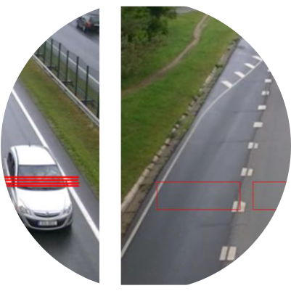
What We Need: Dataset Strategy
Diverse Visual Data
High-resolution images of Indian urban junctions featuring motorcycles, rickshaws, and multi-class vehicles.
Environmental Variance
Datasets captured during night-time, rain, and foggy conditions to ensure year-round reliability.
Annotated Evidence
Precisely labeled helmet-compliant vs. non-compliant riders and regional license plate font variations.

Slide 9
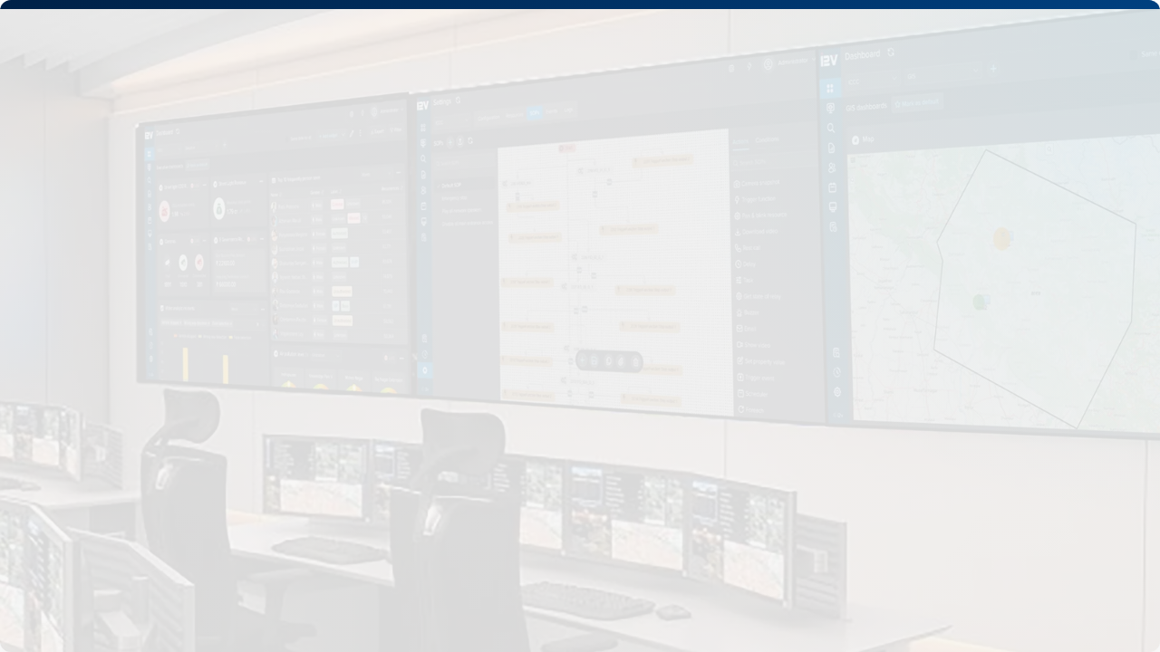

Vision for Scalability
The proposed modular framework is designed for integration into Centralized Command Centers. By processing feeds in parallel, the system can monitor entire metropolitan sectors, feeding real-time violation logs into a unified administrative dashboard for traffic authorities.

Slide 10

Thank You
Smart Traffic Violation Detection System Design
Autonomous Urban Safety Proposal

